Slide 1
Lecture 8
Cascading Style Sheets (CSS)

Slide 2
Overview
Motivation
Levels of style sheets
Style specification formats
Selector forms
Property value forms
Examples of properties – font, list, color, text alignment, background images

Slide 3
Motivation
Consider the management of a corporate web site
  Site identity (look & feel - e.g. corporate image) must be maintained
  Changes in site identity must be implemented across the entire site
A mixture of content and appearance in a data set is difficult to maintain
Stylesheet concept
HTML necessarily mixes style and content, but stylesheets help the separation

Slide 4
CSS
CSS provides the means to control and change presentation of HTML documents
Style sheets allow you to impose a standard style on a whole document, or even a whole collection of documents
CSS1 specification – 1996
CSS2 specification - 1998
CSS level 2 revision 1 (“CSS 2.1”) is a Candidate W3C Recommendation
CSS3 is under development

Slide 5
Levels of Style Sheets
There are three levels of style sheets
Inline - specified for a specific occurrence of a tag and apply only to that tag
  This is fine-grain style, which defeats the purpose of style sheets - uniform style
Document-level style sheets - apply to the whole document in which they appear
External style sheets - can be applied to any number of documents
When more than one style sheet applies to a specific tag in a document, the lowest level style sheet has precedence

Slide 6
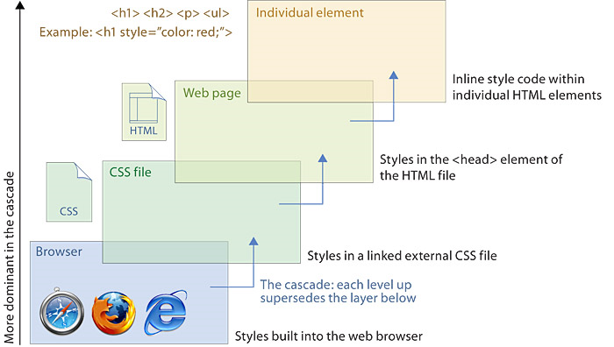
CSS cascade hierarchy

Slide 7
Levels of Style Sheets
Inline style sheets appear in the tag itself
Document-level style sheets appear in the head of the document
External style sheets are in separate files, potentially on any server on the Internet
  Written as text files with type text/css
  A <link> tag is used to specify that the browser is to fetch and use an external style sheet file
<link rel = "stylesheet" type = "text/css"
href = "http://www.wherever.org/example.css">

Slide 8
Inline Style Specification
Style sheet appears as the value of the style attribute
General form:
style = "property_1: value_1;
property_2: value_2;
…
property_n: value_n;"

Slide 9
Document Style Specification
Style sheet appears as a list of rules that are the content of a <style> tag
The <style> tag must include the type attribute, set to "text/css"
  <style type = "text/css">
    rule list
  </style>
Form of the rules:
selector {property_1:value_1; property_2:value_2; …; property_n:value_n;}

Slide 10
External Style Sheet Specification
Form is a list of style rules
  Like the content of a <style> tag for document-level style sheets

Slide 11
Simple Selector
The selector is a tag name or a list of tag names, separated by commas
Examples:
  h1 {font_size: 24pt;}
  h2, h3 {font_size: 20pt;}
Contextual selectors
  Apply style only to elements in specified position in body of document
  List element hierarchy
  body p b {font_size: 30pt}

Slide 12
Class Selector
Used to allow different occurrences of the same tag to have different style specifications
A style class has a name, which is attached to a tag name
  p.narrow {property/value list}
  p.wide {property/value list}
The class you want on a particular occurrence of a tag is specified with the class attribute of the tag
  <p class = "narrow"> ... </p>
  ...
  <p class = "wide"> ... </p>

Slide 13
Generic Selectors
A generic class can be defined if you want a style to apply to more than one kind of tag
A generic class must be named, and the name must begin with a period
  .really-big { … }
Use in body of doc like normal style class
<h1 class = "really-big"> … </h1>
...
<p class = "really-big"> … </p>

Slide 14
id Selectors
An id selector allow the application of a style to one specific element
General form:
  #specific-id {property-value list}
e.g. #section3 {font-size: 20}
In XHMTL doc:
<h2 id = “section3”>
3. Properties for sale
</h2>

Slide 15
Pseudo Classes
Pseudo classes are styles that apply when something happens, rather than because the target element simply exists
Names begin with colons
hover class applies when the mouse cursor is over the element
focus class applies when an element has focus

Slide 16
Properties
There are different properties in 12 categories:
Background
Border and outline
Dimension
Font
Generated content
List
Margin
Padding
Positioning
Print
Table
Text

Slide 17
Property Value Forms
Keywords - left, small, …
Length - numbers, maybe with decimal points
  Units:
    px – pixels
    in – inches
    cm – centimeters
    mm – millimeters
    pt – points
    pc - picas (12 points)
    em - height of the letter ‘m’
    ex-height - height of the letter ‘x’
  No space is allowed between the number and the unit specification, e.g. 1.5 in is illegal!

Slide 18
Property Value Forms
Percentage - just a number followed immediately by a percent sign
URL values
  url(protocol://server/pathname)
Colors
  Color name, e.g. white
  Hex form: #XXXXXX, e.g. #FFFFFF
  rgb(n1, n2, n3), e.g. rgb(255, 255, 255)
    Numbers can be decimal (0-255) or percentages
Property values are inherited by all nested tags, unless overridden

Slide 19
Font Properties
font-family
  Value is a list of font names - browser uses the first in the list it has
font-size
  Possible values: a length number or a name, such as smaller, xx-large, etc.
font-style
  italic, oblique (useless), normal
font-weight - degrees of boldness
  bolder, lighter, bold, normal
font - for specifying a list of font properties
  font: bolder 14pt Arial Helvetica
  Order must be: style, weight, size, font name(s)
fonts.html
fonts2.html

Slide 20
List Properties list-style-type
On unordered lists list-style-type can be used to specify the shape of the bullets
  disc (default), square, or circle
  Set it on either the <ul> or <li> tag
<h3> Fruit </h3>
<ul>
<li style = "list-style-type: disc"> Apple </li>
<li style = "list-style-type: square"> Orange </li>
<li style = "list-style-type: circle"> Pear </li>
</ul>
On ordered lists list-style-type can be used to change the sequence values
sequence_types.html

Slide 21
Text and Background Colour
The color property specifies colour of text
  <style type = “text/css”>
  th.red {color: red}
  th.orange {color: orange}
  </style>
The background-color property specifies the background colour of elements
back_color.html

Slide 22
Background Images
The background-image property
back_image.html
background-repeat property
  Possible values: repeat (default), no-repeat, repeat-x, or repeat-y
background-position property
  Possible values: top, center, bottom, left, or right

Slide 23
Text Alignment
The text-indent property allows indentation
  Takes either a length or a % value
The text-align property has the possible values, left (the default), center, right, or justify
Sometimes we want text to flow around another element - the float property
  values of left, right, and none (the default)
float.html

Slide 24
The <span> and <div> tags
One problem with the font properties is that they apply to whole elements, which are often too large
Solution: a new tag to define an element in the content of a larger element – <span>
The default meaning of <span> is to leave the content as it is
<style type = "text/css">
.bigred {font-size: 24pt; font-family: Ariel; color: red}
</style>
…
<p> Now is the <span class = "bigred"> best time </span> ever! </p>

Slide 25
The <span> and <div> tags
The <span> tag is similar to other HTML tags, they can be nested and they have id and class attributes
Another tag that is useful for style specifications: <div>
  Used to create document sections (or divisions) for which style can be specified
  e.g., a section of five paragraphs for which you want some particular style

Slide 26
Summary
Motivation
Levels of style sheets
  Inline, document, external
Style specification formats
Selector forms
  Simple, class, generic, id, pseudo classes
Property value forms
Examples of properties
  font, list, color, text alignment, background images
<span> and <div> tags

